Slide 1


Analysis of crime data in Manchester (UK) and correlation with EPL games in August 2018.
Yuan-Hung Chien
Mykyta Yarovoi
Miguel Lopez Palacio

Slide 2
The Project
• What did we research?
Our project compares the correlation of crimes during August 2018 and soccer games played.
• Our theory:
Crimes in Manchester are lower during EPL soccer games.
• The data:
We found 2 datasets in Kaggle (Manchester Crimes, and EPL 2018 season games)
Notes:
We had to cleanup and convert one of those from mysql to csv to be able to work, Jimmy helped us
Next Nick is going to show us some of the code and the cleanup process that we went through with these data sets

Slide 3
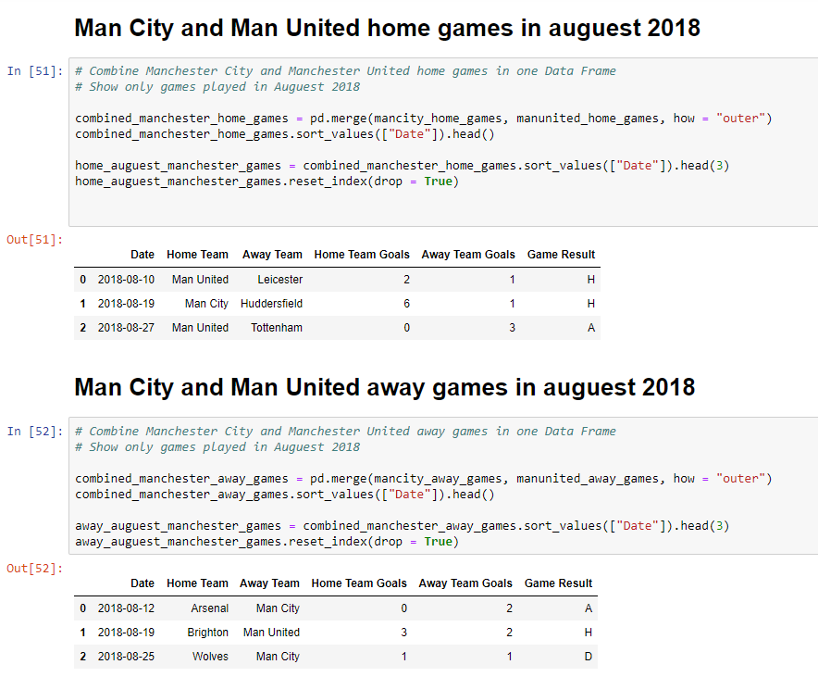
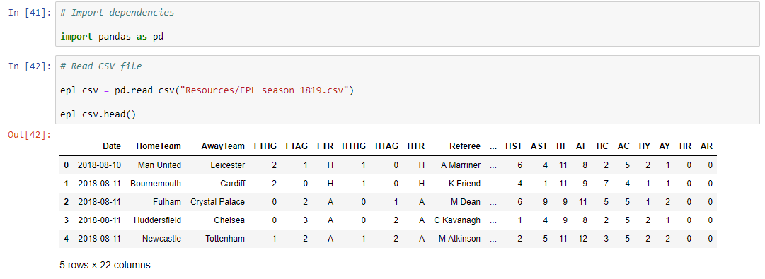
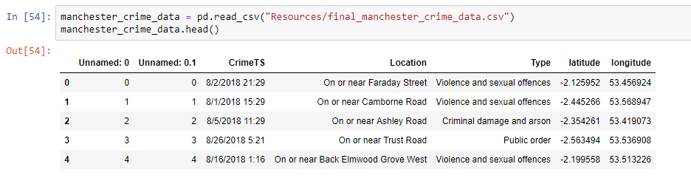
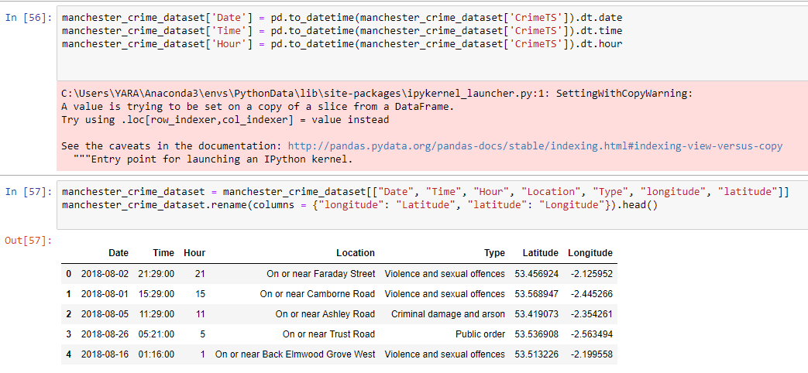
Example Code - Dataset Cleanup
Notes:
1 slide - raw data contains 380 rows. We renamed columns, sorted values and merged dataframes
2 slide - the final result of cleaning and manipulation with data. First data shows all games in August happened in Manchester and the second data shows all games in August happened away of Manchester
3 slide - raw data contains more than 5000 rows. This data provides all crimes happened in August in Manchester
4 slide - manipulation with data (used function .to_datetime to date, time and hour separately for easier work)

Slide 4
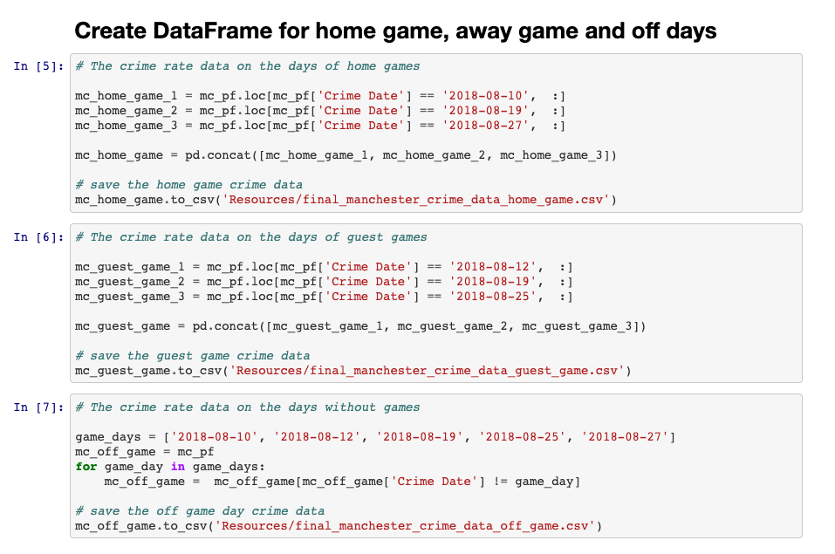
Example Code - Combine Data Based on Dates
Notes:
mc_…. - Manchester Crime
This particular slide shows coding process when we merge datas to collect total crimes in home, away and off games
(Yuan used .concat (allows to merge more then 2), we could use .merge 1 and 2nd and then 1+2 and 3)

Slide 5
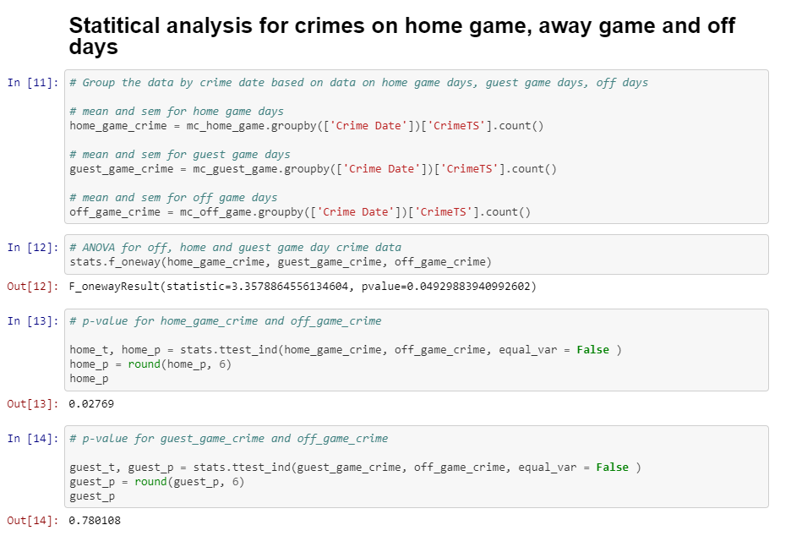
Example Code - Significance
Notes:
Slide 3 - statistical analysis
We checked is it any significant difference between all 3 datas, pvalue is 0.04929, so we need to find which one exactly were significant.
We used ttest for that

Slide 6
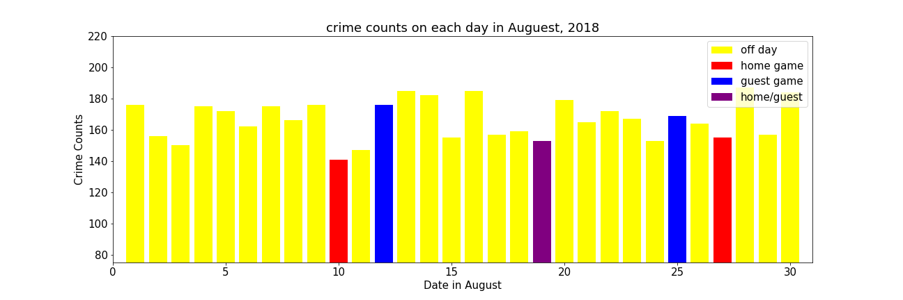
Daily Crime Counts - August 2018
Notes:
Nick - First basic graph shows amount of crimes for each day in August

Slide 7
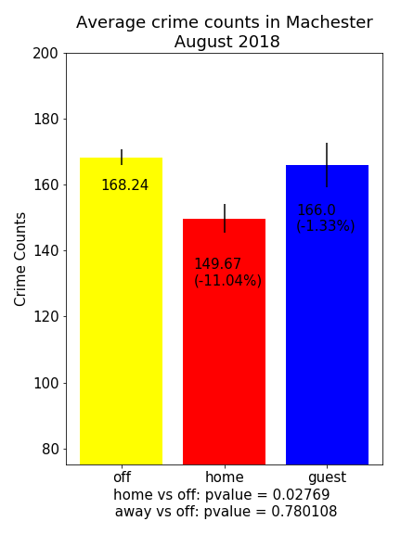
Avg Crimes Reported by Day
Notes:
Nick - Visualization of significant difference between home and off game

Slide 8
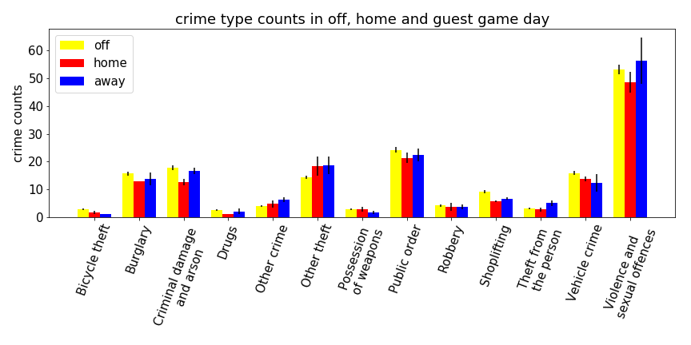
Avg Crimes Types
Notes:
Yuan -

Slide 9
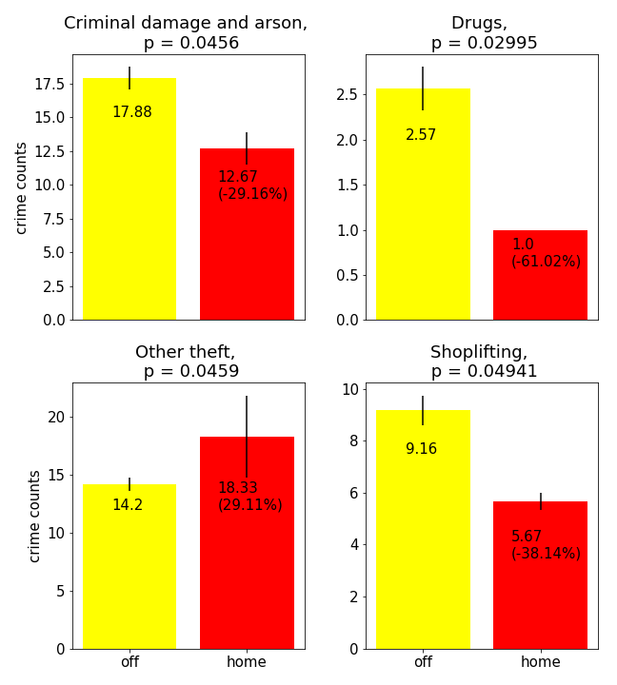
Avg Crimes Reported by Type - Home Games
Notes:
Yuan - There are only 4 Types which have significant difference between HOME and OFF games!

Slide 10
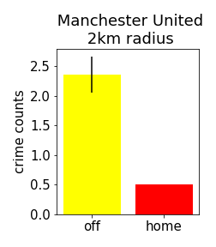
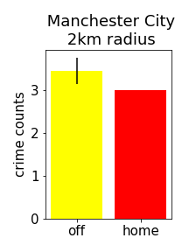
Crimes Reported Around the Stadium
Notes:
Yuan - There are only 2 Types which have significant difference between AWAY and OFF games!

Slide 11
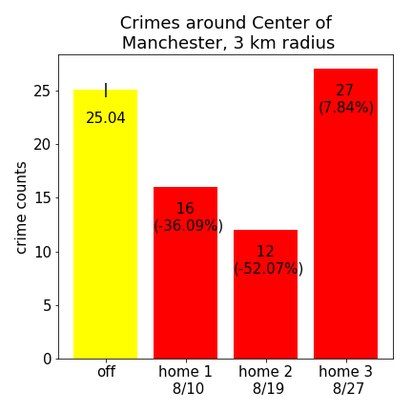
Crimes around the center of the city

Slide 12
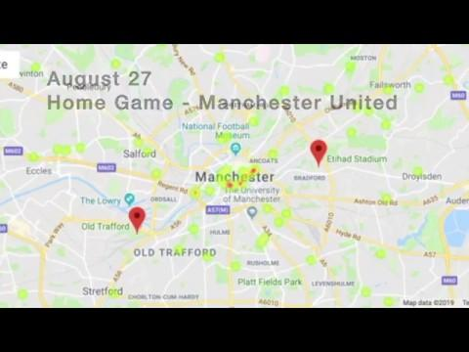
Crimes by Day
Notes:
Miguel
- We used gmaps to plug in crime locations based on the lat & lon columns from the crimes reported data set for each day in August
- We also defined stadium locations with latitude and longitude for each of the Manchester stadiums
- This short clip goes over the entire month of August and shows a heatmap for approximate location of crime reports - Notice how crimes are lower in close proximity to the stadium, very likely due to high security around the stadium radius

Slide 13
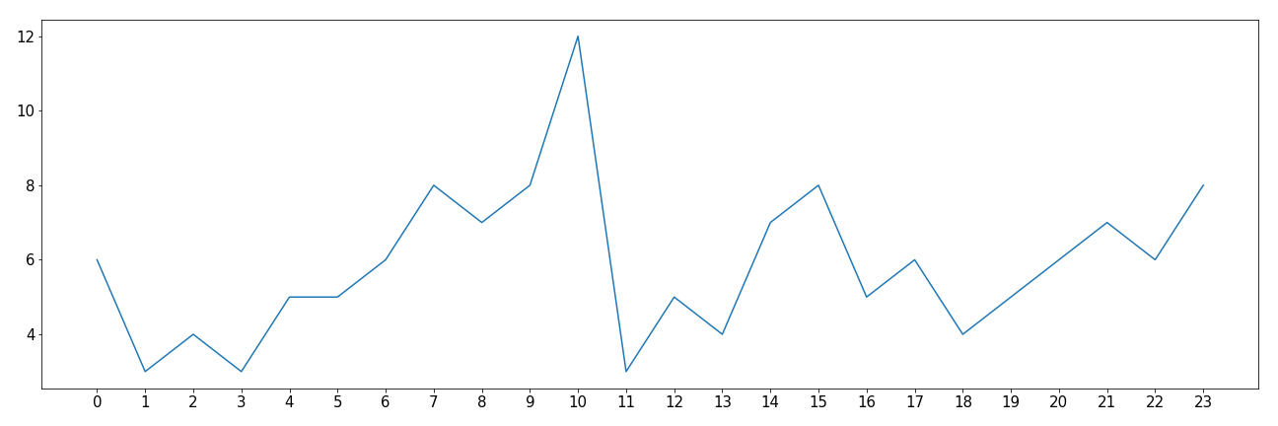
Crimes by Hour - First Home Game
(08/10/2018)
Count of Crimes
Hour of Day
Notes:
Miguel
For this section we reformatted the timestamp on the Manchester crime data set with a function called:
pd.to_datetime(df['CrimeTS']).dt.time
pd.to_datetime(df['CrimeTS']).dt.hour
To format the date as Y/M/D and the hours as H:M:S
For each of the dates when a homegame happened in Manchester
We grouped the crime reports by hour
Then we did a count for the amount of crimes reported by hour
During this game:
Manchester United played against Leicester at 8 PM.
MU won 2 - 1.
The highest amount of crimes reported this day were around 10am
During the game crime reports started going up, dropped around halftime, and went back up after the game
This was a trend for all of the home games, crime decreased around half-time, but it picked up after the game ended

Slide 14
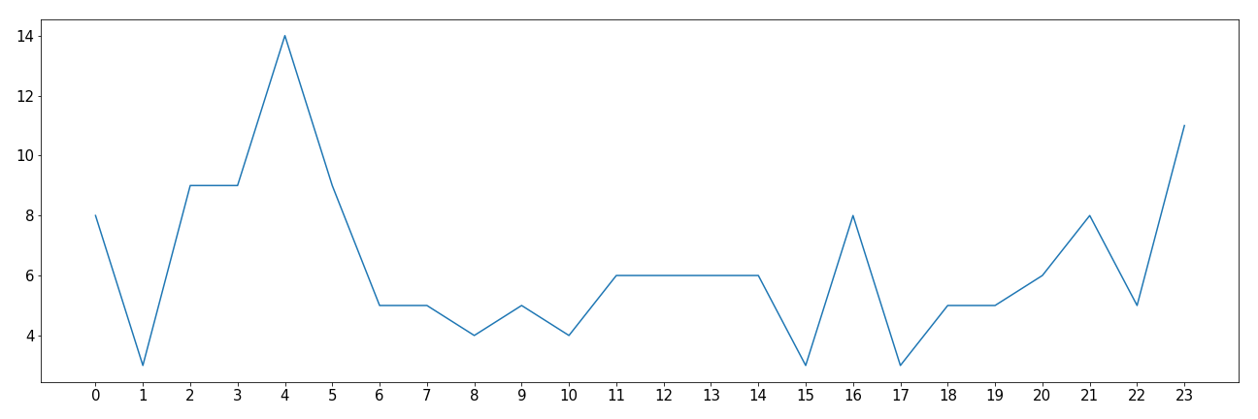
Crimes by Hour - Second Home Game
(08/19/2018)
Count of Crimes
Hour of Day
Notes:
Miguel
Manchester City played against Huddersfield at 1 PM.
They won 6 - 1.
Limitations
We only had crime data for August 2018, which is the first month of the 2018/2019 EPL season.
There are only five game days (3 home, 3 away and 1 overlap) in Manchester in August 2018, So we have limited data for our statistical analysis
8/27 is also a national holiday in England. And we can not rule out that the activities on national holiday also affected the crime rate on that day.
The hourly data depends on the time when crime were reported, not really the same time that crime occurred.
We have not compared our data with the data from other cities, since we didn’t have other crime data available for other cities.

Slide 15
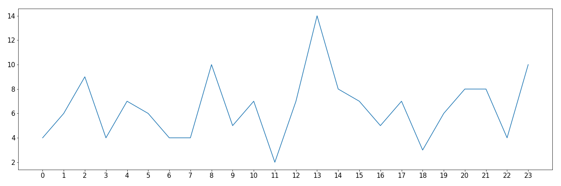
Crimes by Hour - Third Home Game
(08/27/2018)
Count of Crimes
Hour of Day
Notes:
Miguel
Manchester City played against Tottenham at 8 PM.
They lost 0 - 3.
Violence and sexual offenses remain the same after the game
Burglary increases after the game
Other theft also increases after the game
Conclusion is play more soccer, our hypothesis was partially true, crimes are lower DURING soccer games, in the locations where the soccer games are being played.

Slide 16
Conclusion
• Our theory:
Crimes in Manchester are lower during EPL soccer games.
• Findings:
Partially true, crimes are lower during soccer games but only on the cities were the game is being played.

